Slide 1

Text processing and Retrieval (cs5700) Executive M. tech. in data sciences iit hyderabad
Maunendra Sankar Desarkar

Slide 2
Text Processing and Retrieval
The source of data for this assignment will be: http://jmcauley.ucsd.edu/data/amazon/
Download reviews for any three product types.
Consider any time period (Say date A to Date B)
Consider the number of reviews for different products belonging to those categories

Slide 3
Task-1
Identify most frequent terms in the reviews. For each category, mention the top 20 of them. Do not include stop words for this exercise.
Identify most frequent nouns in the reviews. For each category, mention the top 20 of them.
Identify most frequent adjectives/adverbs in the reviews. For each category, mention the top 20 of them.
Do you have any observations from the the above analysis?

Slide 4
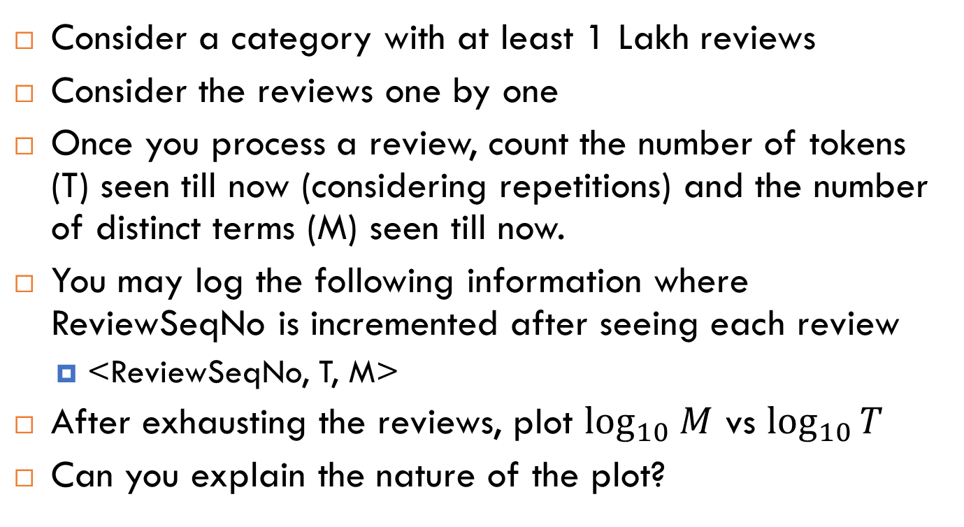
Task-2
Consider a category with at least 1 Lakh reviews
Consider the reviews one by one
Once you process a review, count the number of tokens (T) seen till now (considering repetitions) and the number of distinct terms (M) seen till now.
You may log the following information where ReviewSeqNo is incremented after seeing each review
<ReviewSeqNo, T, M>
After exhausting the reviews, plot $\log_{10} M$ vs $\log_{10}⁡T$
Can you explain the nature of the plot?

Slide 5
Deliverables
A report. The report should contain your tables, graphs and your observations from the tables and graphs. If you want to include any interesting point/observation that you may have made by looking at the results, feel free to include that. Make sure to mark your name and roll number in the report.
Zip together the code files and the report. Name the zip file as <your-roll-no>_A1.zip.
Department plagiarism policy: https://cse.iith.ac.in/?q=node/254

